Slide 1
Cryptocurrencies & NFTs
Carlos Perches, Ethan Sandman

Slide 2



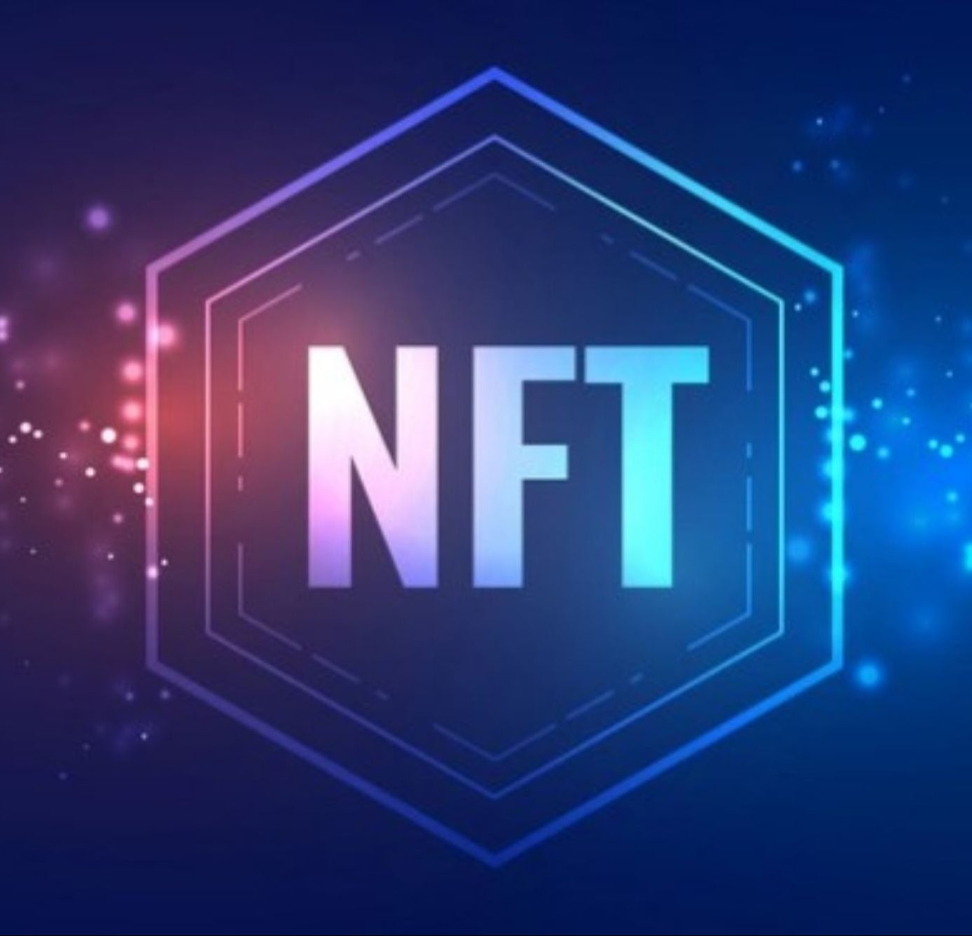

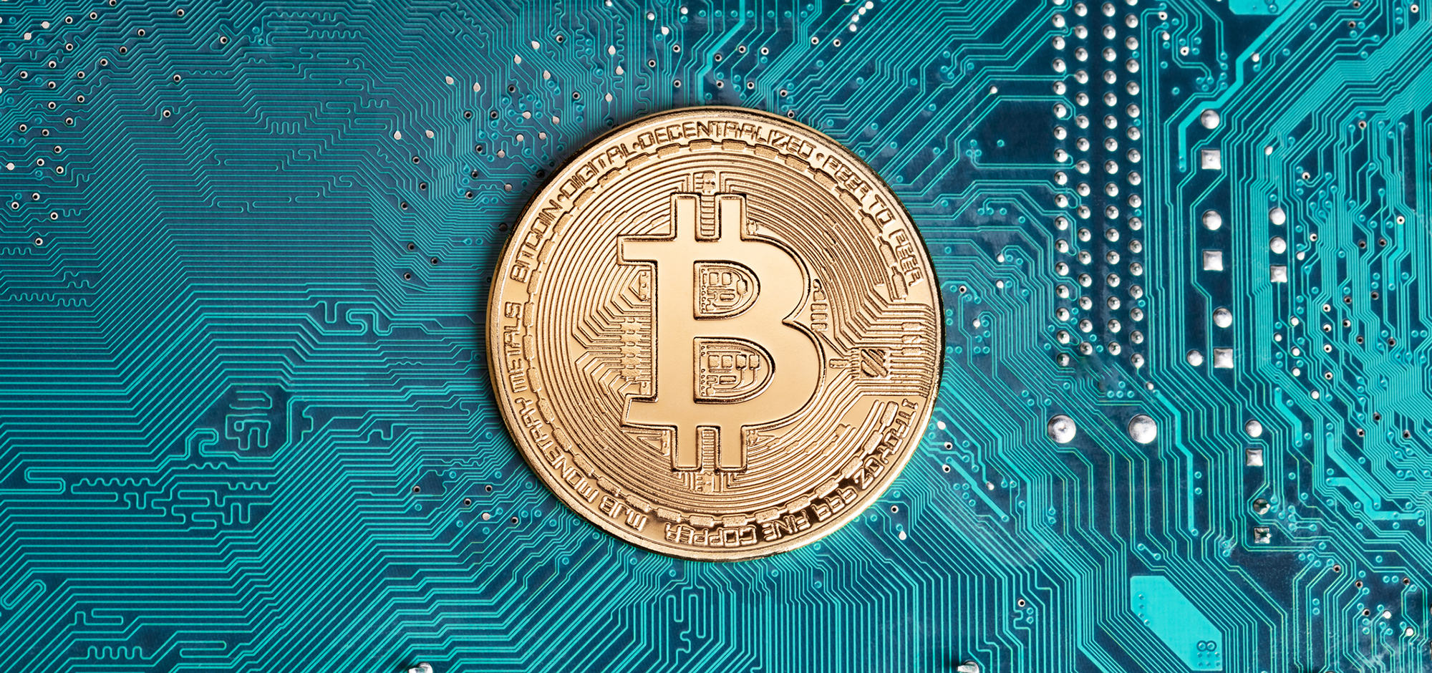
Introduction
What is blockchain?
How do NFTs and Crypto currencies work?
Why is all this important to us?

Slide 3
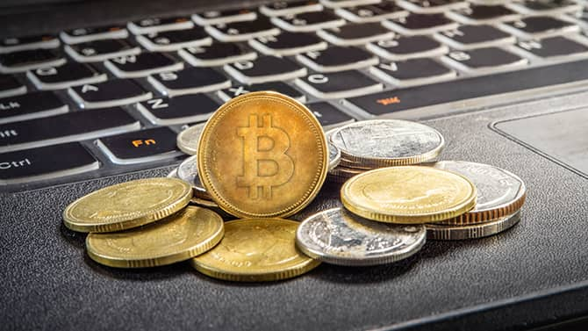
What is Crypto
Digital Currency
Powered by a technology called Blockchain
Crypto prices is Volatile, the industry is filled with uncertainty

Slide 4
Types of Cryptocurrencies
Bitcoin
Ethereum
Dogecoin
Cardano
Solana

Slide 5
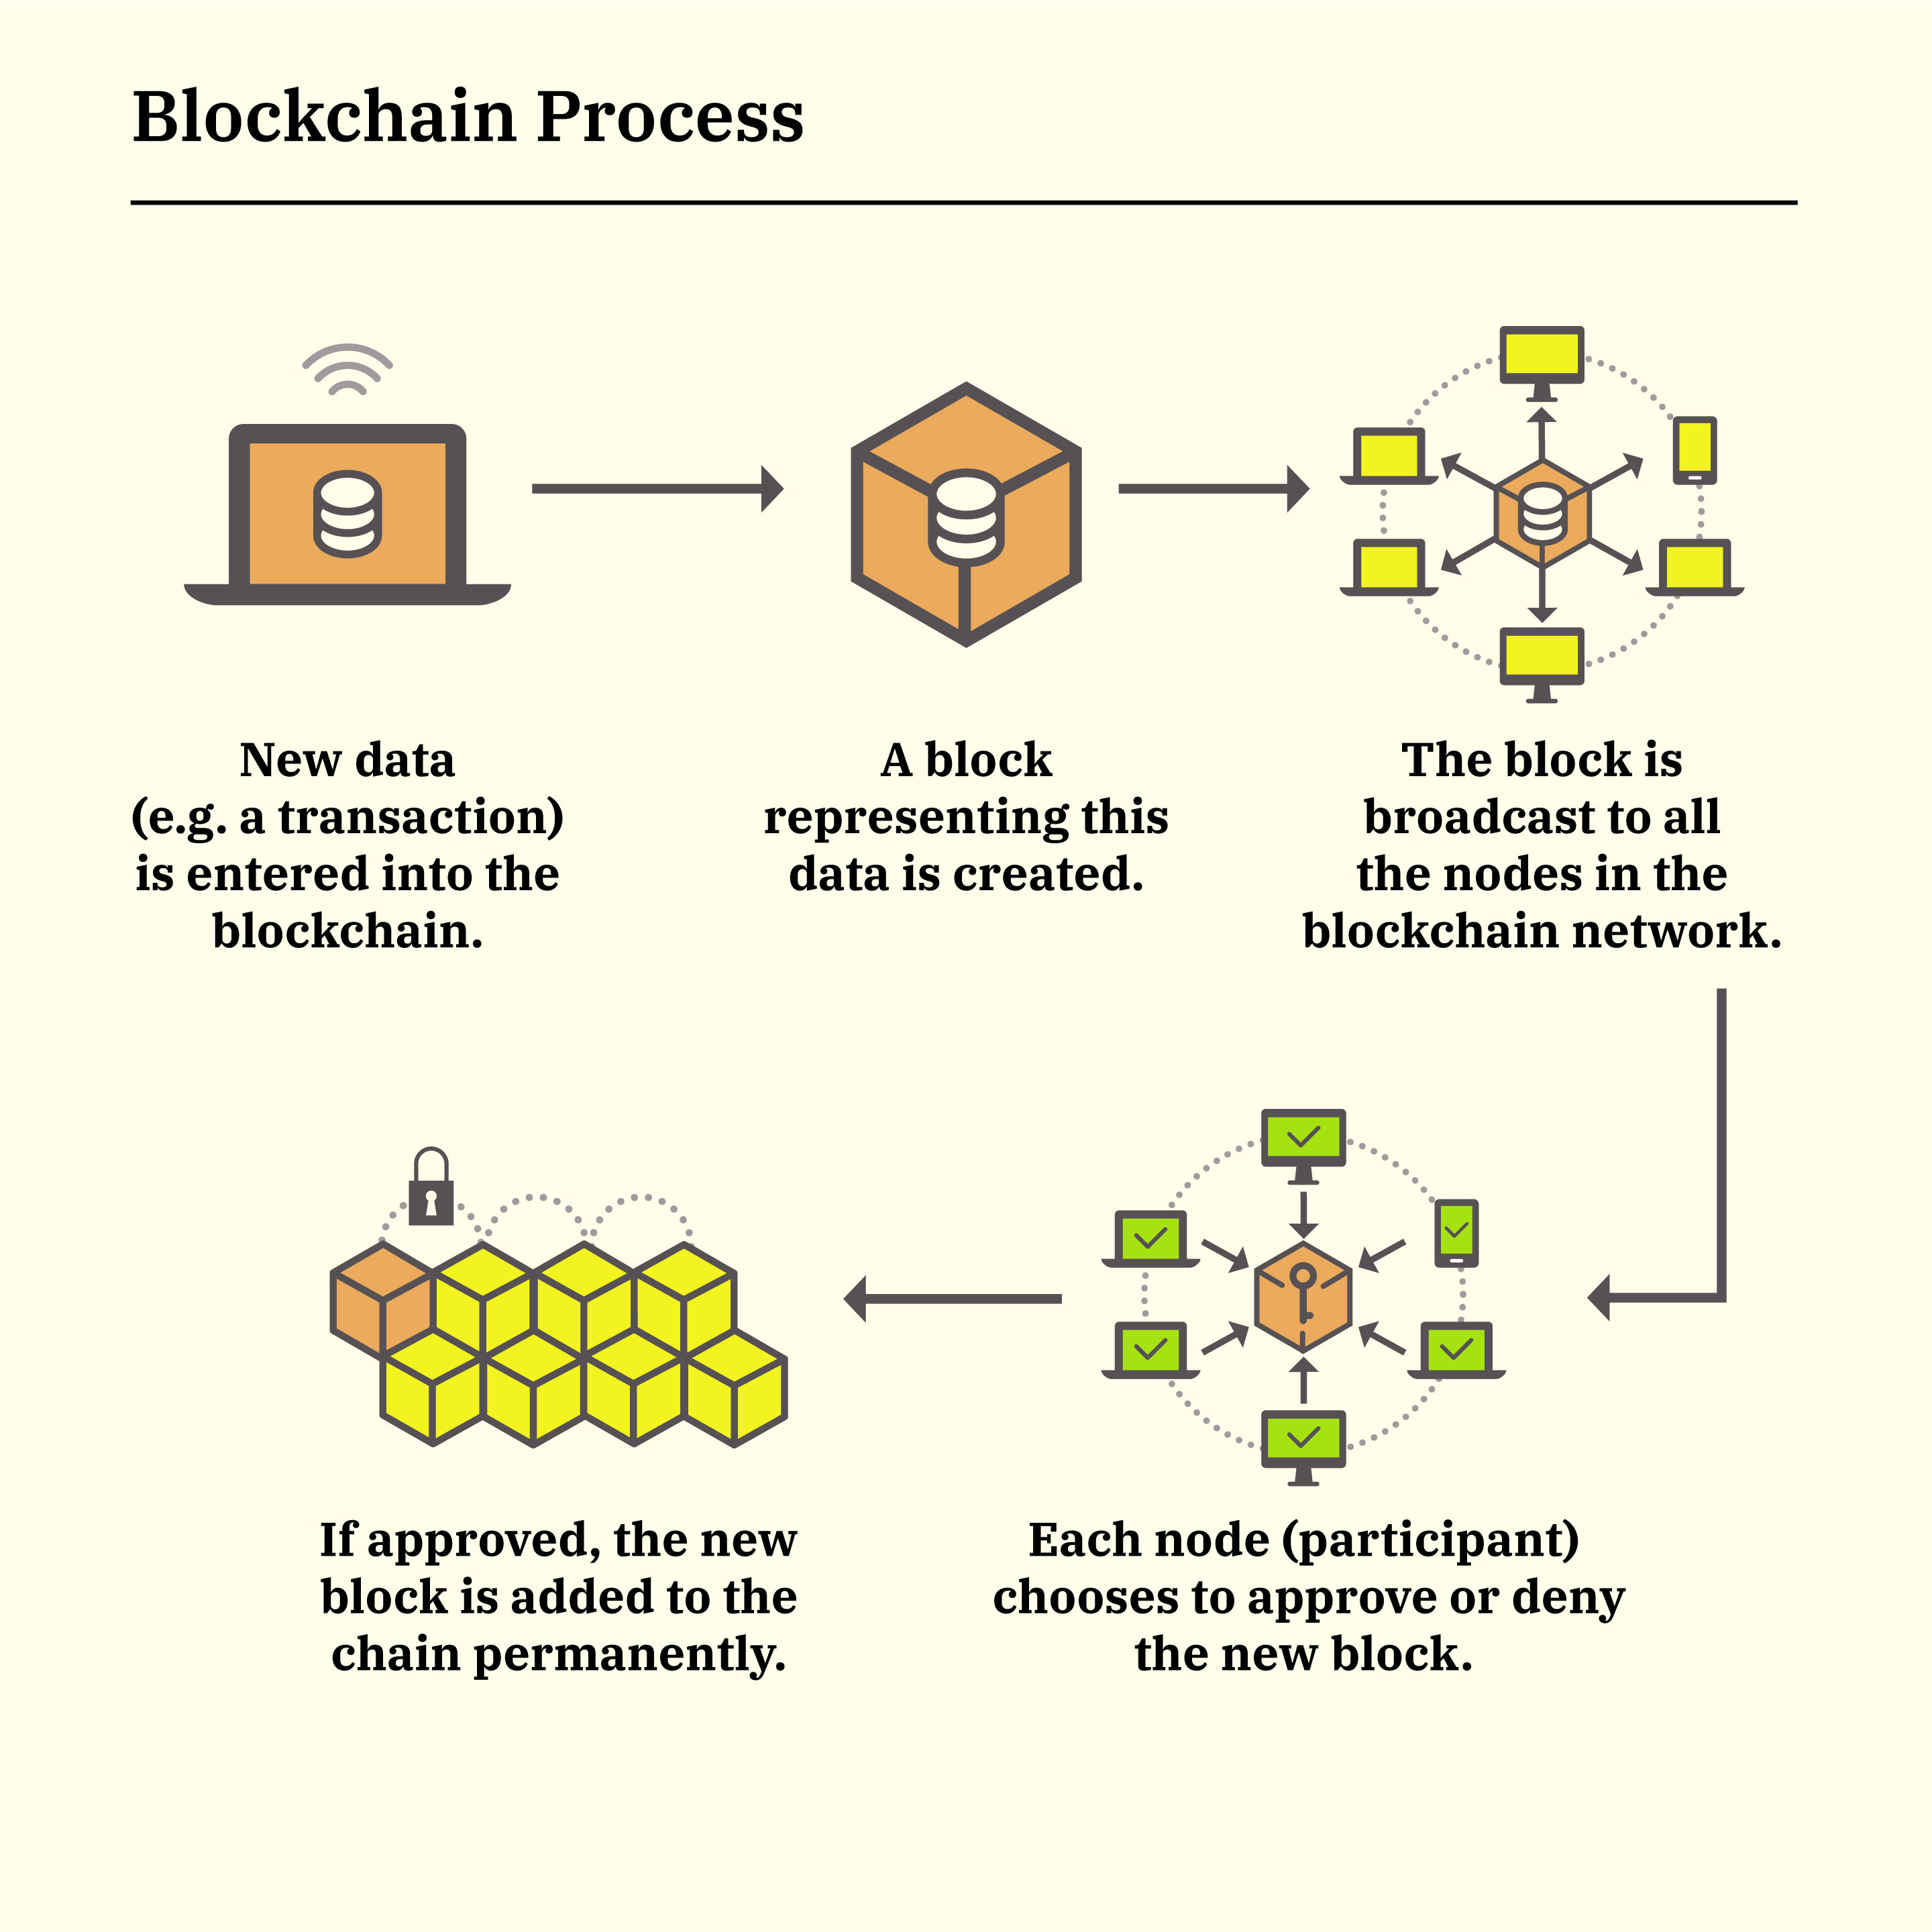
Blockchain
Continuously growing
A digital ledger used to record transactions across computers
Contains multiple types of transactions
Almost impossible to change the Block’s data
Flexible

Slide 6
Why Does Crypto Work
There are more than 2 million cryptocurrencies that are operational
Cryptocurrencies are made through mining
There are many different types of Cryptocurrency used for different transactions.

Slide 7
Pros
Removes Crypto from centralized banks
Blockchain is decentralized
Some currencies offer owners passive income

Slide 8
Cons
Many currencies are untested
Blockchain has not been widely adapted
Rapid change in prices
Mining takes twice as much power
Governments do not know how to handle Crypto

Slide 9

What are NFTs
NFT (Non-fungible Tokens)
Non-fungible meaning you can’t interchange the NFT
Each NFT is unique and is stored on the blockchain
NFTs are a piece of digital art that anyone can create
Are a way of allowing people to “officially” own digital art

Slide 10

Types of NFTs
Digital Art
Algorithmically generated, also most popular type of NFT
GIFS
Allows the author to tokenize their animation, which gives them ownership of the animation
Virtual land and real-estate
People are paying millions to buy virtual land in the “Metaverse”
Music NFTs
Used by artists, to allow them to sell their music directly to their fans
Trading cards and collectables
Like trading cards in real life, this form of trade is also in NFT form which allows people to collect trading cards online as well

Slide 11
About NFTs
Most NFTs are part of the Ethereum Blockchain
Blockchain is used to keep track of who owns each NFT and tracks any trades that happen
NFTs are used to represent people's online property/belongings
Meant to be easily transferable, verifiable, and safe from fraud
Created by minting tokens
This is where the person’s asset is given an identifier and then uploaded to the blockchain
NFTs also follow standardization to work with Blockchain

Slide 12
ERC-721(Ethereum Request for Comments 721) Standard
One of the more popular standards that formalized NFTs name
Allowed for authentication and ownership
Ensures no NFT will be the same
An ETH game called CrptoKitties is what led to the first true legitimate token standard ERC-721
These types of standards are incorporated into developer's smart contracts
Many other standards also exist

Slide 13
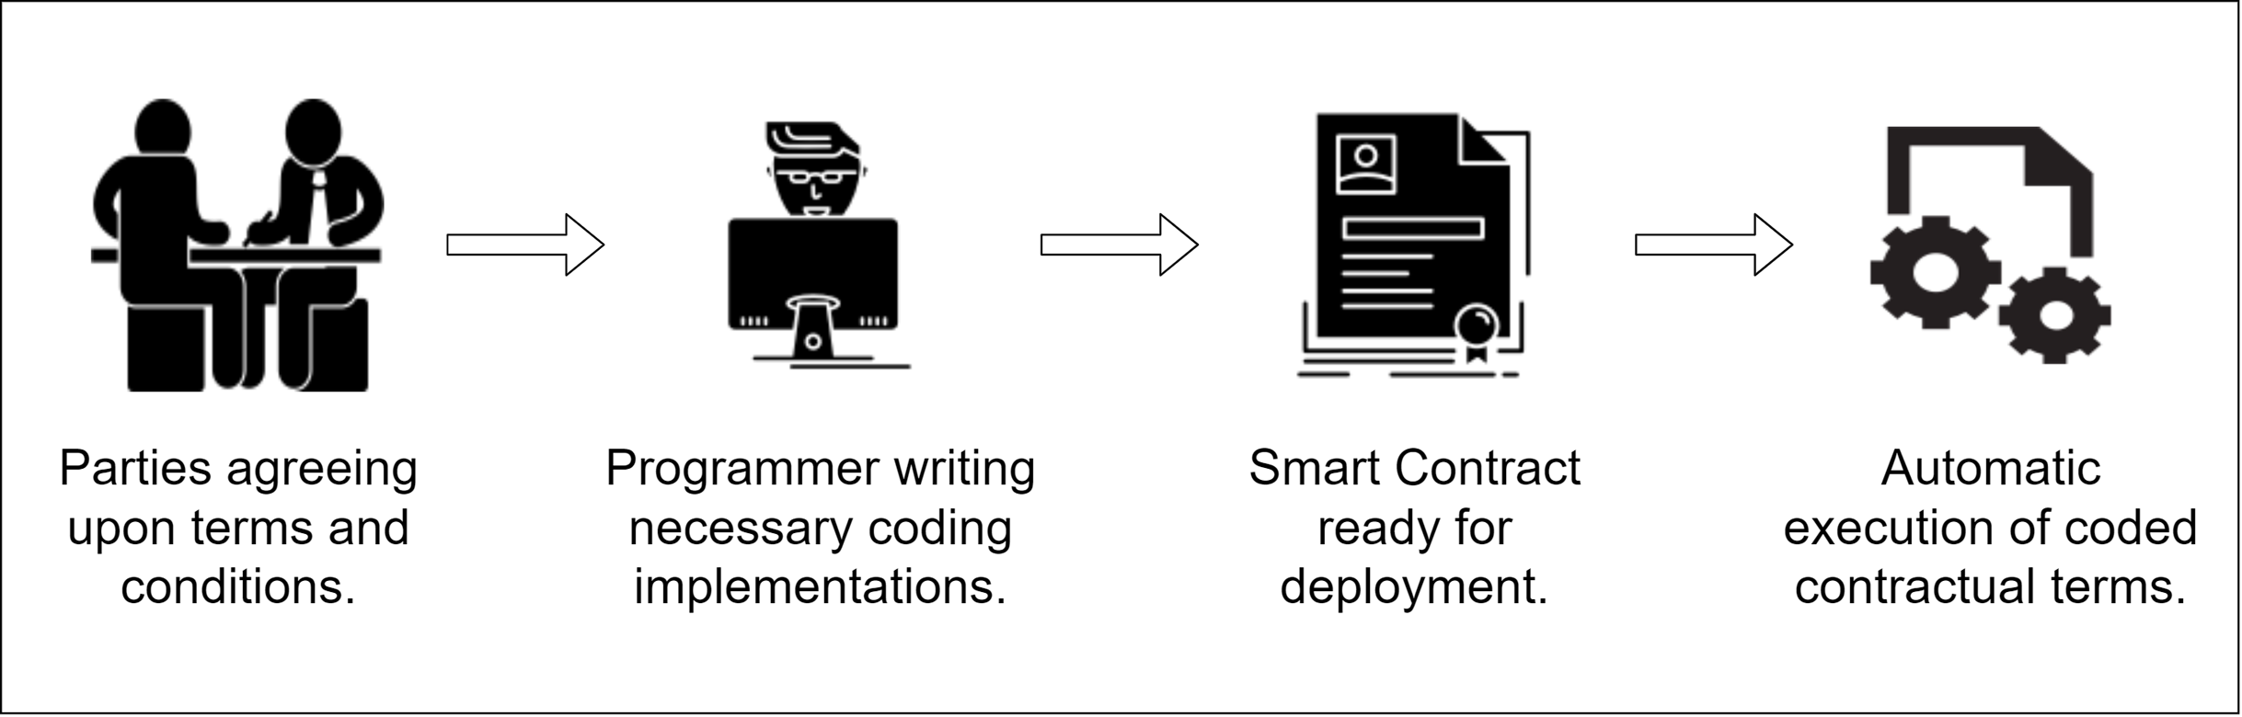
Smart Contracts
5 main steps in a smart contract
Offer
Negotiation
Approval
Satisfying Conditions
Transaction

Slide 14
Why use Smart Contracts?
Benefits of Smart Contracts
Cost-effective
Time saving
Secure
Accurate
Speed

Slide 15
The Dark Side of Crypto/NFTs: Understanding Scam Risks
Crypto and NFTs have many pros but with all things, there are bound to be downsides
Types of scams
Pump-and-Dump Scams
Phishing Scams
Counterfeit/Plagiarized NFTs

Slide 16
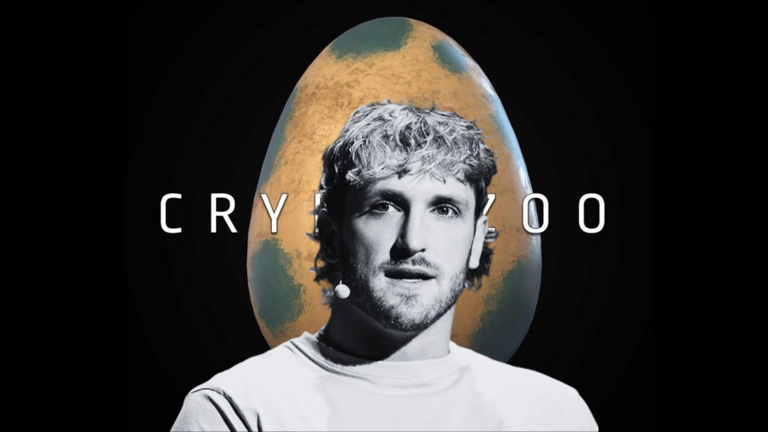
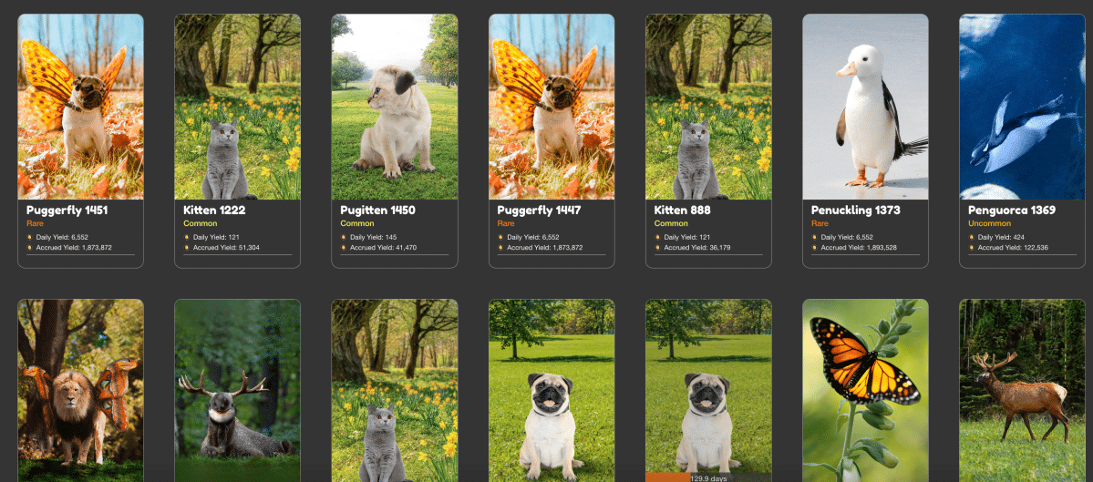
Logan Paul’s Crypto Zoo Pump-and-Dump Scam
In 2021 Logan Paul via Twitter continuously promoted Crypto Zoo as the next big thing
A game where users would purchase NFT eggs with ETH or ZOO token and hatch them to reveal unique animals
It quickly gained popularity and the in-game currency boomed in value
Logan Paul’s team then sold and walked away with the profits

Slide 17
Decentralized Finance(DeFi)
Purpose of DeFi is to remove third parties from financial transactions
Like a bank except without all the hassle
DeFi is much faster
DeFi is fairly new as it was released in 2009 alongside bitcoin
DeFi is still an up-and-coming thing

Slide 18
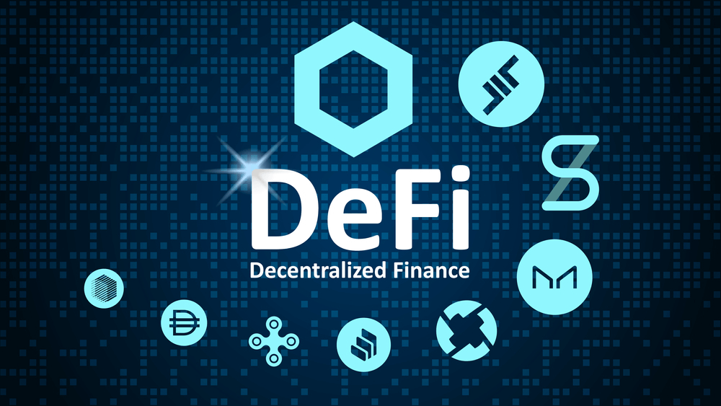
Pros of DeFi
DeFi is not subject to private information unlike banks
Using DeFi allows for autonomy
Reduced risk of fraud
Users have full control of data
DeFi allows users to be flexible with their assets

Slide 19
Sources
https://www.theverge.com/22310188/nft-explainer-what-is-blockchain-crypto-art-faq
https://en.wikipedia.org/wiki/Non-fungible_token
https://en.wikipedia.org/wiki/ERC-721
https://www.coinbase.com/learn/crypto-basics/what-is-defi?utm_source=google_search_nb&utm_medium=cpc&utm_campaign=9943088770&utm_content=127915792732&utm_term=&utm_creative=580583551396&utm_device=c&utm_placement=&utm_network=g&utm_location=9028925&gclid=CjwKCAiA5L2tBhBTEiwAdSxJX48uQ2RHqmkzVb1_nruYI66RNBAJ-s4z6MLo_79erql2jbPdfrRiFBoC2EkQAvD_BwE
https://stackbrowser.com/blog/types-of-nfts#:~:text=Art%20NFTs%20are%20the%20most,%2C%20profile%20pictures%2C%20and%20avatars.
https://www.nerdwallet.com/article/investing/cryptocurrency#:~:text=Most%20cryptocurrencies%20are%20based%20on,copy%20of%20the%20historical%20ledger
https://www.fool.com/terms/b/blockchain/
https://www.investopedia.com/tech/most-important-cryptocurrencies-other-than-bitcoin/

Slide 20


Questions?

